Slide 1
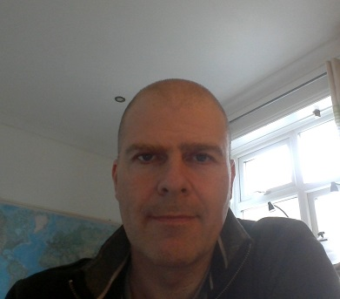

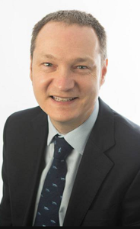

Careers and Placements
Ed Symes- external placements co-ordinator
esymes@plymouth.ac.uk
Mila Mileva- internal placements co-Ordinator
mila.mileva@plymouth.ac.uk
Paul Gillard- psychology careers advisor
paul.gillard@plymouth.ac.uk
Lindsay Marshall- psychology placements advisor
placements@plymouth.ac.uk

Slide 2
Careers strategy Stage 1:
Feb-March: 2x 0.5 day workshops ‘enhance your future’ (run in small groups, with tutorial support for event given in PSYC414)- Workshops help students to make the most of University and enhance their career prospects. Students will leave with a personal careers action plan.
PREPARE, MINDSET- “…reflect on their career aspirations, skills, experiences and areas for development in preparation for graduate employment and further study.”

Slide 3
Careers strategy Stage 2:
Oct- Nov (PSYC515) and Feb-March (PSYC516): Curriculum content (applied topics, careers input, tutorials, pre-placement sessions); Feb: 1 day event- careers fair.
LEARN, FIND OUT- students are given information and opportunities to explore careers

Slide 4
Careers strategy Stage 3:
Aug-June: Placement year
EXPERIENCE- students get work experience

Slide 5
Careers strategy Stage 4:
Sept/ Oct:
2hr session ‘Launching your graduate career’- exploring graduate options, recruitment timelines, postgrad study, application and interview techniques
1hr follow-up ‘Gaining the edge in graduate recruitment’- speculative approaches to employers, elevator pitches and sourcing work experience
1hr- ‘Graduate options in mental health and wellbeing’- Exploring diverse range of options in healthcare, entry pathways, and next steps for final year students.
Nov/ Dec; Mar/ Apr:
Individual appointments and group guidance sessions
Feb: 1 day event- careers fair;
ACTIVE PRACTICE- networking; recruitment/ selection practice; applications, interviews; confidence; articulating skills etc.

Slide 6
Placements information sites
Placement preparation site: CPIE 202 (2022)
https://dle.plymouth.ac.uk/course/view.php?id=60254
Placement year site
https://dle.plymouth.ac.uk/course/view.php?id=60255
Placement Monitoring System
https://www.psy.plymouth.ac.uk/placementmonitoring/Login

